Slide 1
Event Horizon
Made by Vig Zoltán Tamás and Szilágyi Dávid István

Slide 2

Purpose and Background of the Project :
The aim of our project was to create a central hub for various festivals, thereby speeding up the process of searching for programs.
The essence of the website was to find everything in one place quickly and easily.

Slide 3

Database Design :
We aimed to create a database where all data is perfectly visible and easily understandable for every employee. Our database comprises 7 tables, and there are relationships among them, allowing us to demonstrate which table corresponds to which. To assist with this, we created a diagram that presents the tables and their relationships.

Slide 4
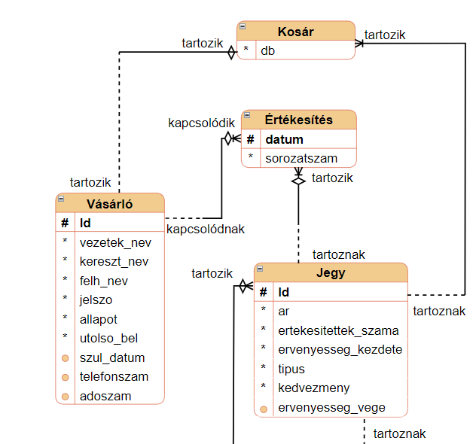
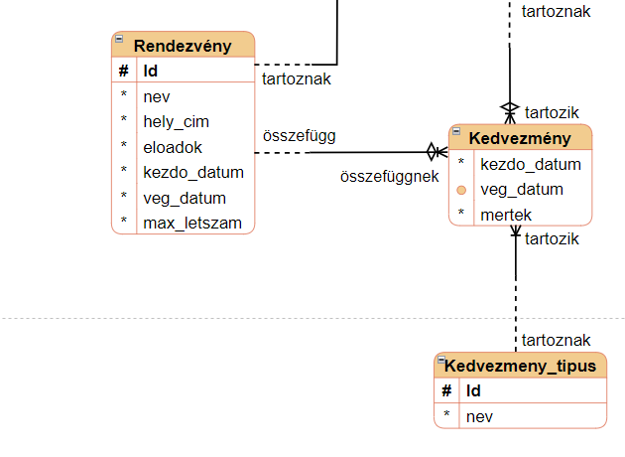
Demonstration
Logical model
In the logical model, we first indicate the relationships and denote which entity is optional and which is not in the respective tables.

Slide 5
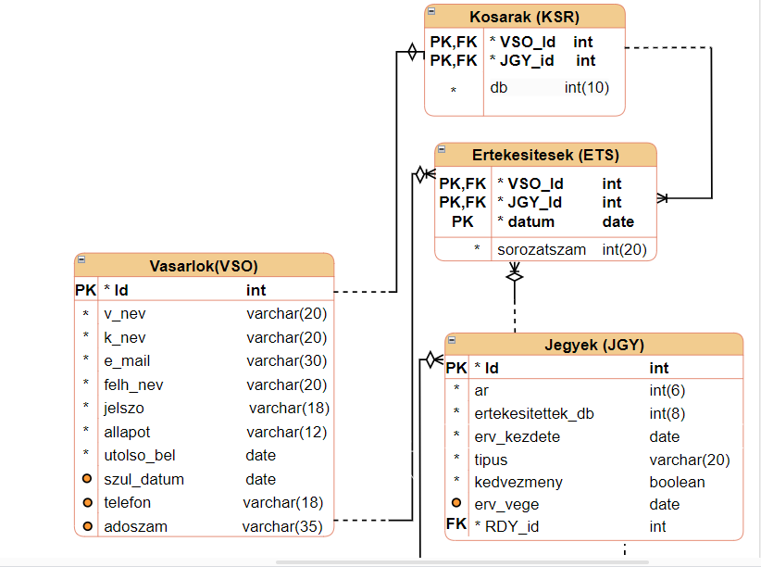
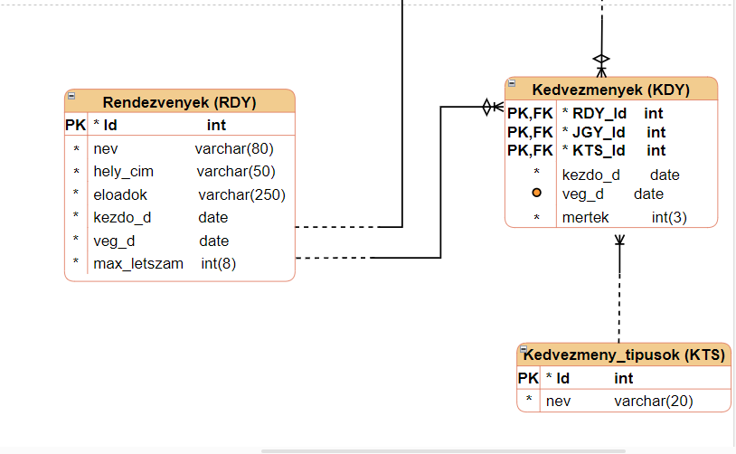
Physical model
The seven main tables
Customers
Tickets
Events
Discounts
Cart
Discount
Types
Sales

Slide 6
Business rules
Some important business rules:
The number of tickets sold cannot exceed the max_capacity.
The price changes associated with types are stored in the Discount entity under the attribute "amount".
For individuals, providing the date of birth is mandatory.
The status of customer profiles is stored in the "status" attribute (active, inactive, deleted).
For companies, providing the tax identification number (TIN) is mandatory.
Discounts are checked on a daily basis.

Slide 7
SQL Codes We are now going to see how we created the individual tables in the database.
Here is the SQL code for creating the "Vasarlok" (Customers) table
CREATE TABLE `vasarlok` (
`Id` int(11) NOT NULL,
`v_nev` varchar(20) NOT NULL,
`k_nev` varchar(20) NOT NULL,
`e_mail` varchar(30) NOT NULL,
`felh_nev` varchar(20) NOT NULL,
`jelszo` varchar(18) NOT NULL,
`allapot` varchar(12) NOT NULL,
`utolso_bel` date NOT NULL,
`szul_datum` date DEFAULT NULL,
`telefonszam` varchar(18) DEFAULT NULL,
`adoszam` varchar(35) DEFAULT NULL
) ENGINE=InnoDB DEFAULT CHARSET=utf8mb4 COLLATE=utf8mb4_hungarian_ci;

Slide 8
SQL Codes
Here is the SQL code for creating the "Rendezvenyek" (Events) table:
CREATE TABLE `rendezvenyek` (
`Id` int(11) NOT NULL,
`nev` varchar(80) NOT NULL,
`hely_cim` varchar(50) NOT NULL,
`eloadok` varchar(250) NOT NULL,
`kezdo_d` date NOT NULL,
`veg_d` date NOT NULL,
`max_letszam` int(8) DEFAULT NULL,
`kep` varchar(180) DEFAULT NULL
) ENGINE=InnoDB DEFAULT CHARSET=utf8mb4 COLLATE=utf8mb4_hungarian_ci;

Slide 9
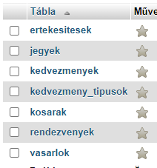
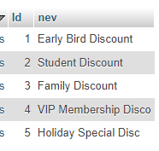
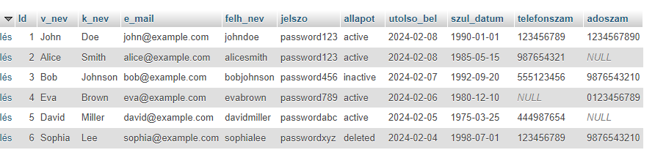
Here are some images of the database.

Slide 10
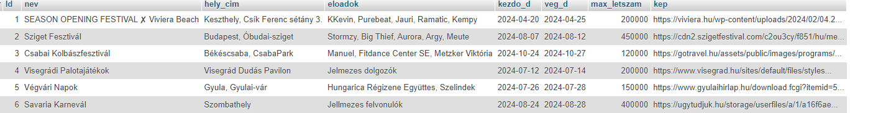
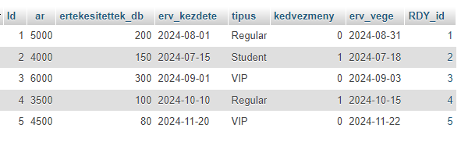
Here are some images of the database.

Slide 11
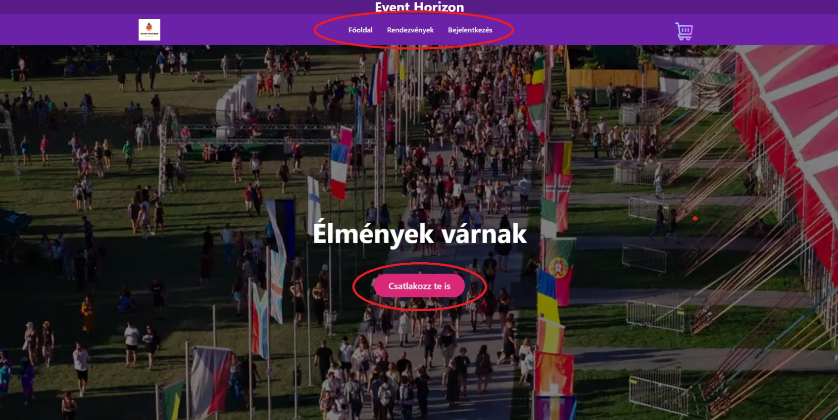
The Main Page
As soon as we open the page, a video pops up, playing continuously, with a button below it leading to the events. However, at the top of the page, we find the navbar, which has various functions.

Slide 12
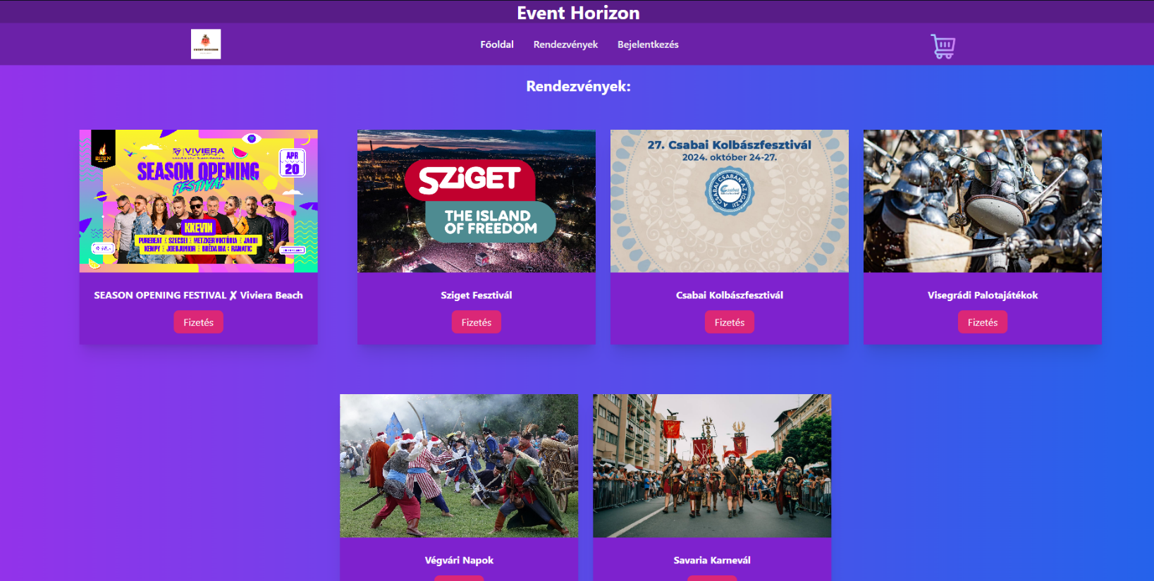
Data Loading
When we click on the Events menu, we can see how the events we have added to the database have been perfectly loaded onto the page.

Slide 13
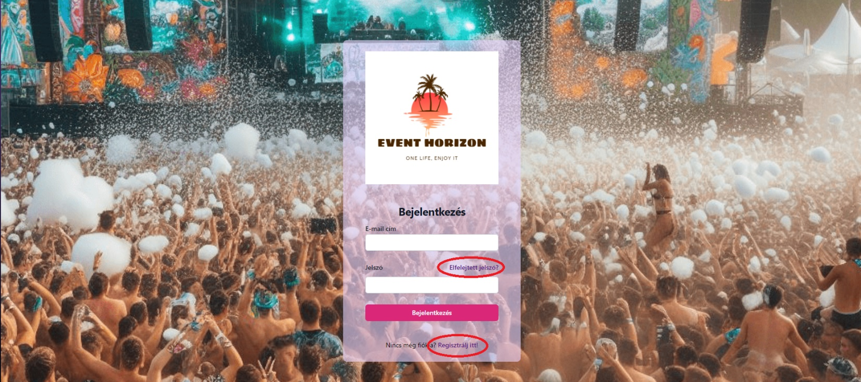
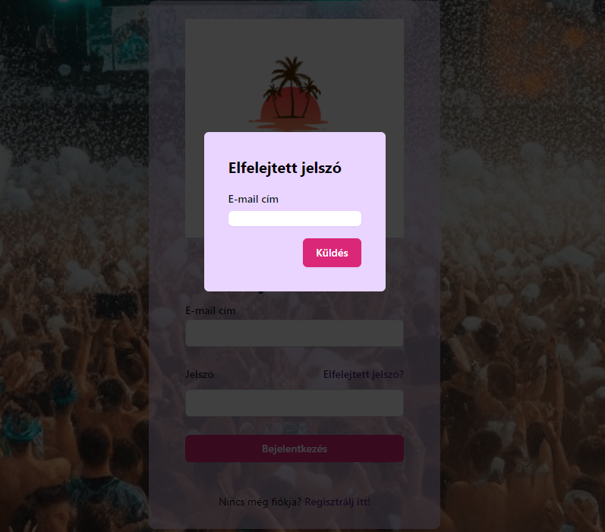
Login and Registration
On the login tab, we see a typical login page where we have the option to register or even request an email for our forgotten password.

Slide 14
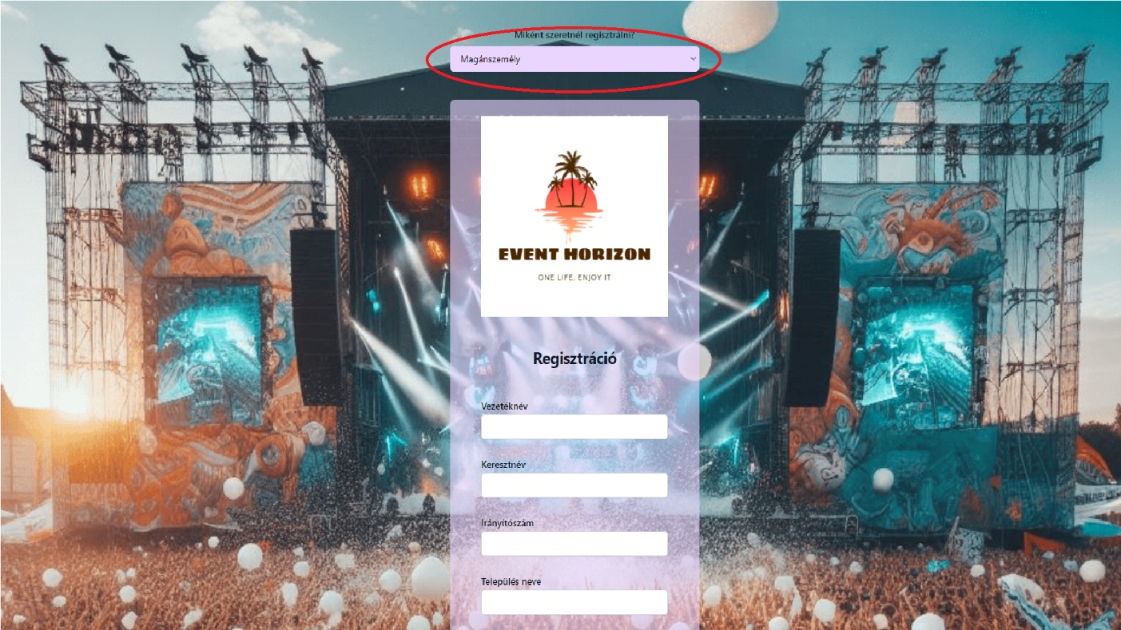
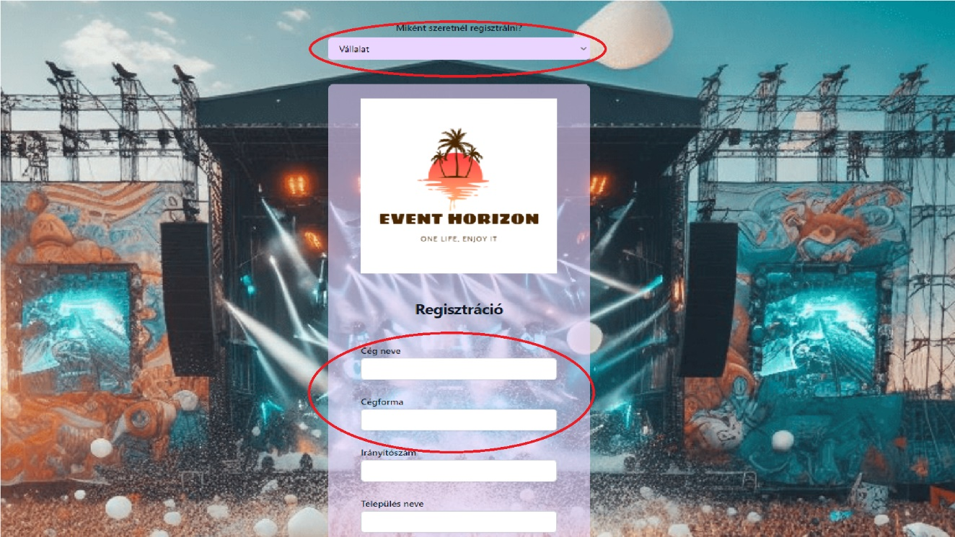
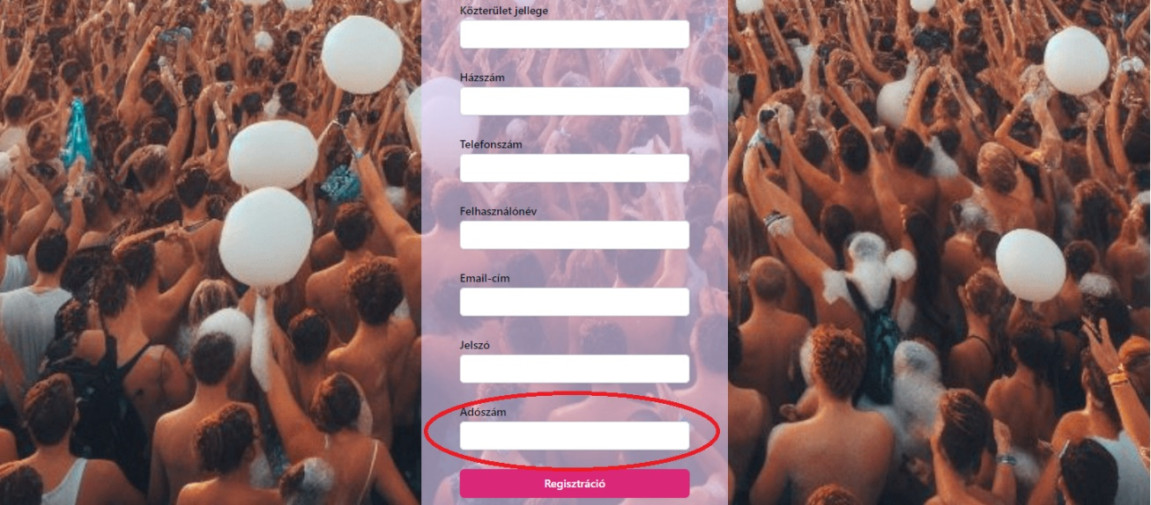
Registration
During registration, nothing changes for individuals, but as soon as we switch to registering as a company, the "Last Name" and "First Name" fields change, and an additional field for the tax number (required) appears.

Slide 15
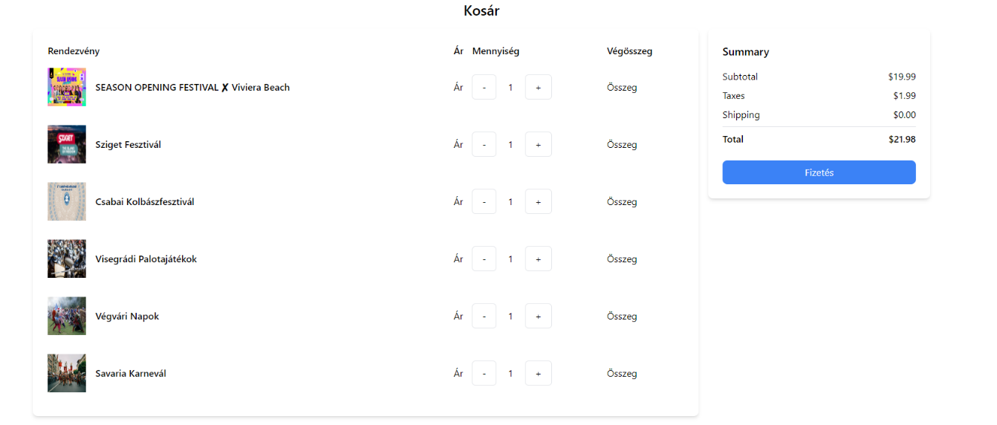

Plans for the future
In the near future, we would like to complete those features for which we did not have enough time, such as the cart and perhaps fill the site with even more content to make it even more user-friendly.

Slide 16
Thank you for your attention!
Sources:
https://www.google.com/url?sa=i&url=https%3A%2F%2Fithub.hu%2Fblog%2Fpost%2FAz_5_leggyakoribb_adatbazis_fejlesztesi_hiba&psig=AOvVaw0Ml7Lf8sDz3T41nWWXuZeI&ust=1707549276800000&source=images&cd=vfe&opi=89978449&ved=0CBAQjRxqFwoTCJCDpfLanYQDFQAAAAAdAAAAABAD
https://www.google.com/url?sa=i&url=https%3A%2F%2Fwww.trisotech.com%2Fbpmn-database-operations-with-odata%2F&psig=AOvVaw1kd9nPYtRCm8w0eWcsNRKe&ust=1707549316224000&source=images&cd=vfe&opi=89978449&ved=0CBAQjRxqFwoTCKiCvYXbnYQDFQAAAAAdAAAAABAD
https://www.google.com/url?sa=i&url=https%3A%2F%2Fwww.linkedin.com%2Fpulse%2F4-phases-create-database-design-martin-tolovski&psig=AOvVaw1kd9nPYtRCm8w0eWcsNRKe&ust=1707549316224000&source=images&cd=vfe&opi=89978449&ved=0CBAQjRxqFwoTCKiCvYXbnYQDFQAAAAAdAAAAABAI
And Google Drive

